Slide 1
Weekly report: Electrical Drivetrain
Week number: 7
Date: 11/11/2025
Supervisor: Prof. Dr.-Ing. Saiju
Group members: Aiswarya Vijayan, Vishranti Shivajirao Patil , Girish Mahadeo Padalkar, Cristina Milene Vergara Hernandez

Slide 2
List of contents
Generator :DFIG
Generator Front and Side View
Generator Component views
DFIG Design Parameters
Our offering design- ABB
Next steps
Girish Padalkar
Electrical Drive Train/ Optimus Syria

Slide 3
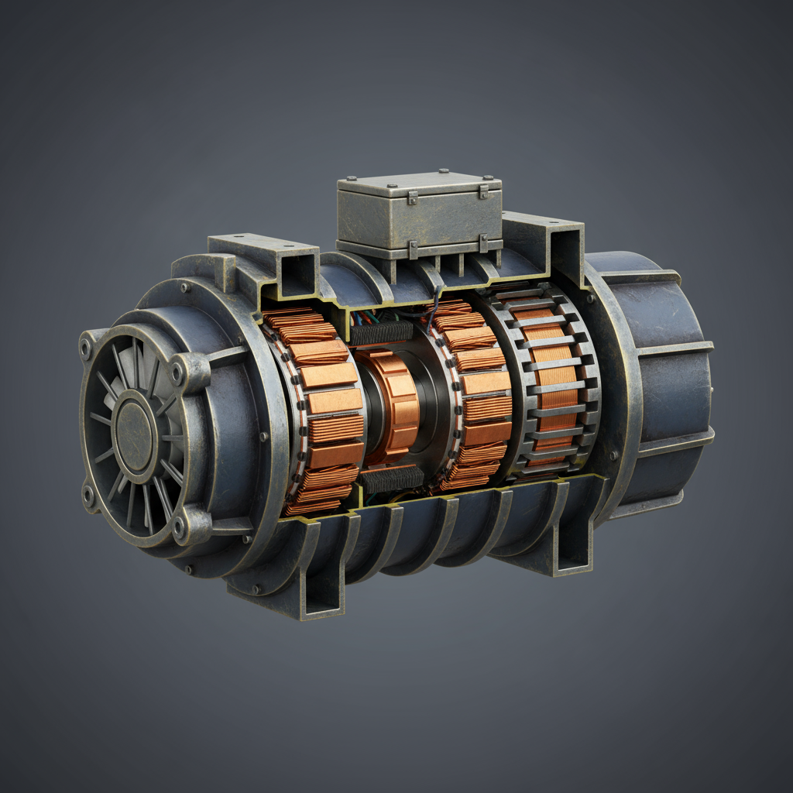
1.Generator: DFIG
Active Power | 5 MW
Voltage output | 0.69 kV
Power factor | 0.9
Speed | 1000 rpm
Frequency | 50 Hz
Efficiency | 98 %
Dimensions | 3080mm x 1724mm(Diameter) x 1724mm
Weight | 155,845 kg (about 156 tons)
Estimated cost | €400,000 to €600,000
Electrical Drive Train/ Optimus Syria

Slide 4
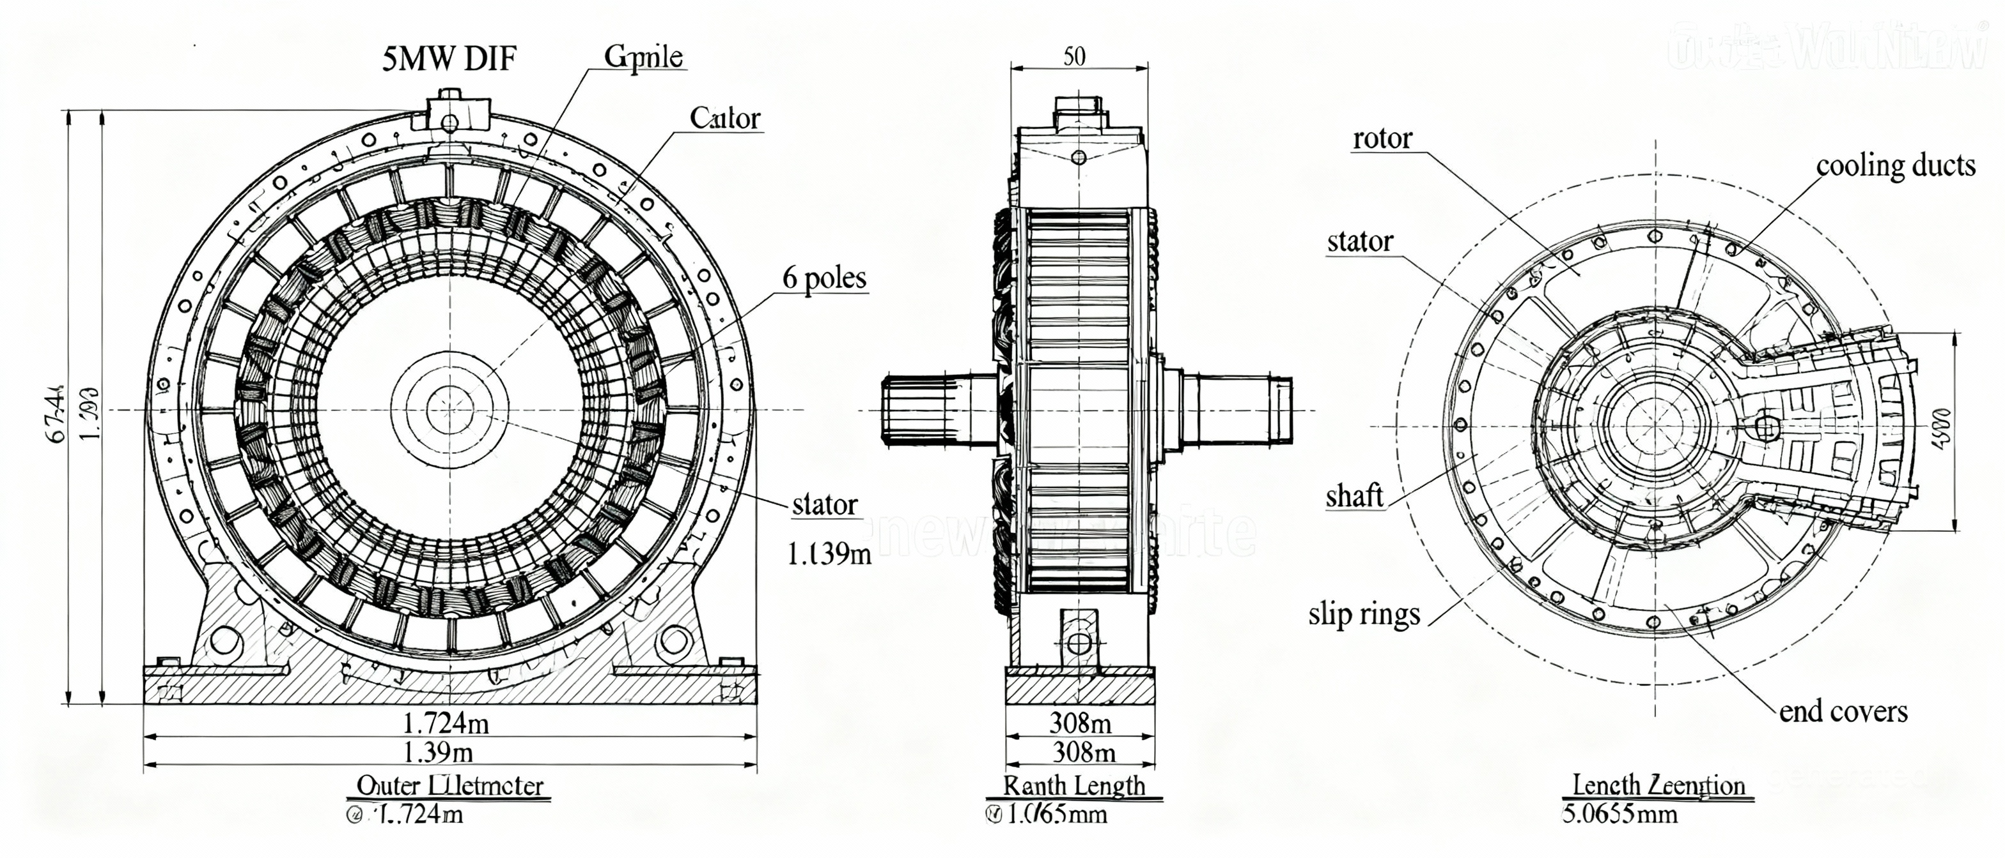
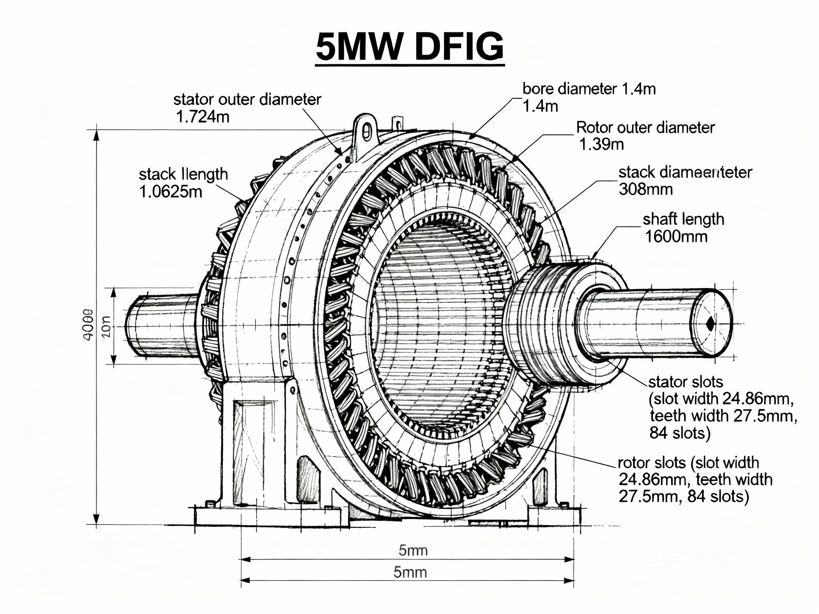
2. Generator front and side views
Girish Padalkar
Electrical Drive Train/ Optimus Syria

Slide 5
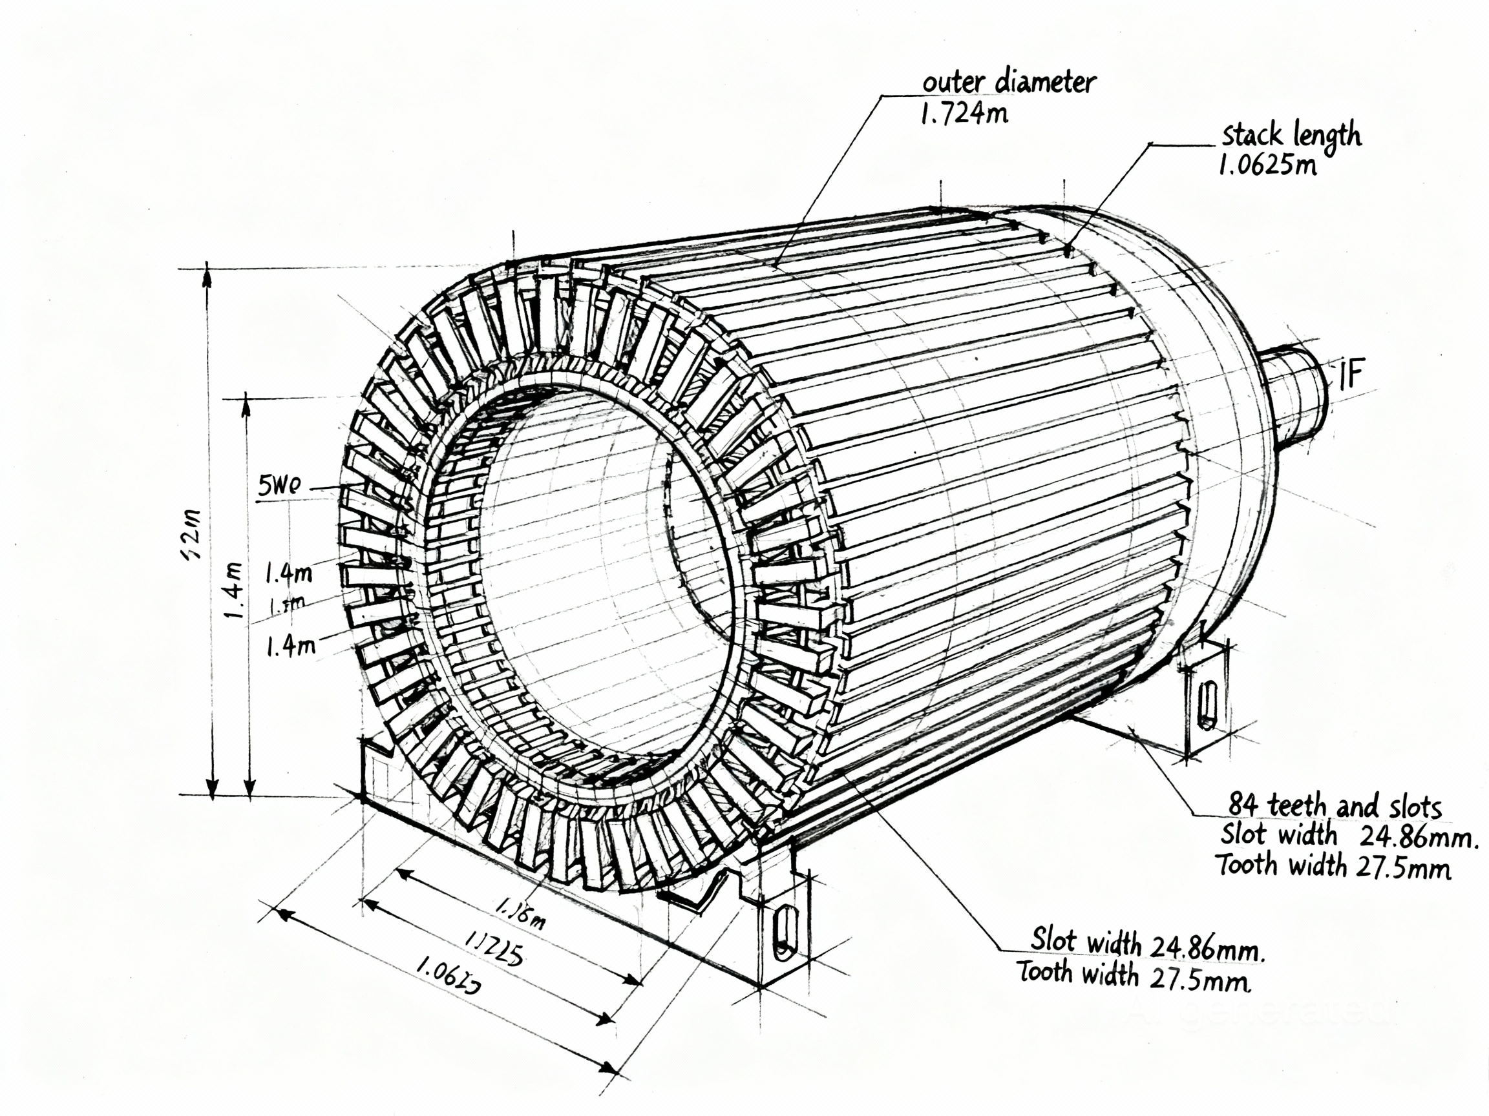
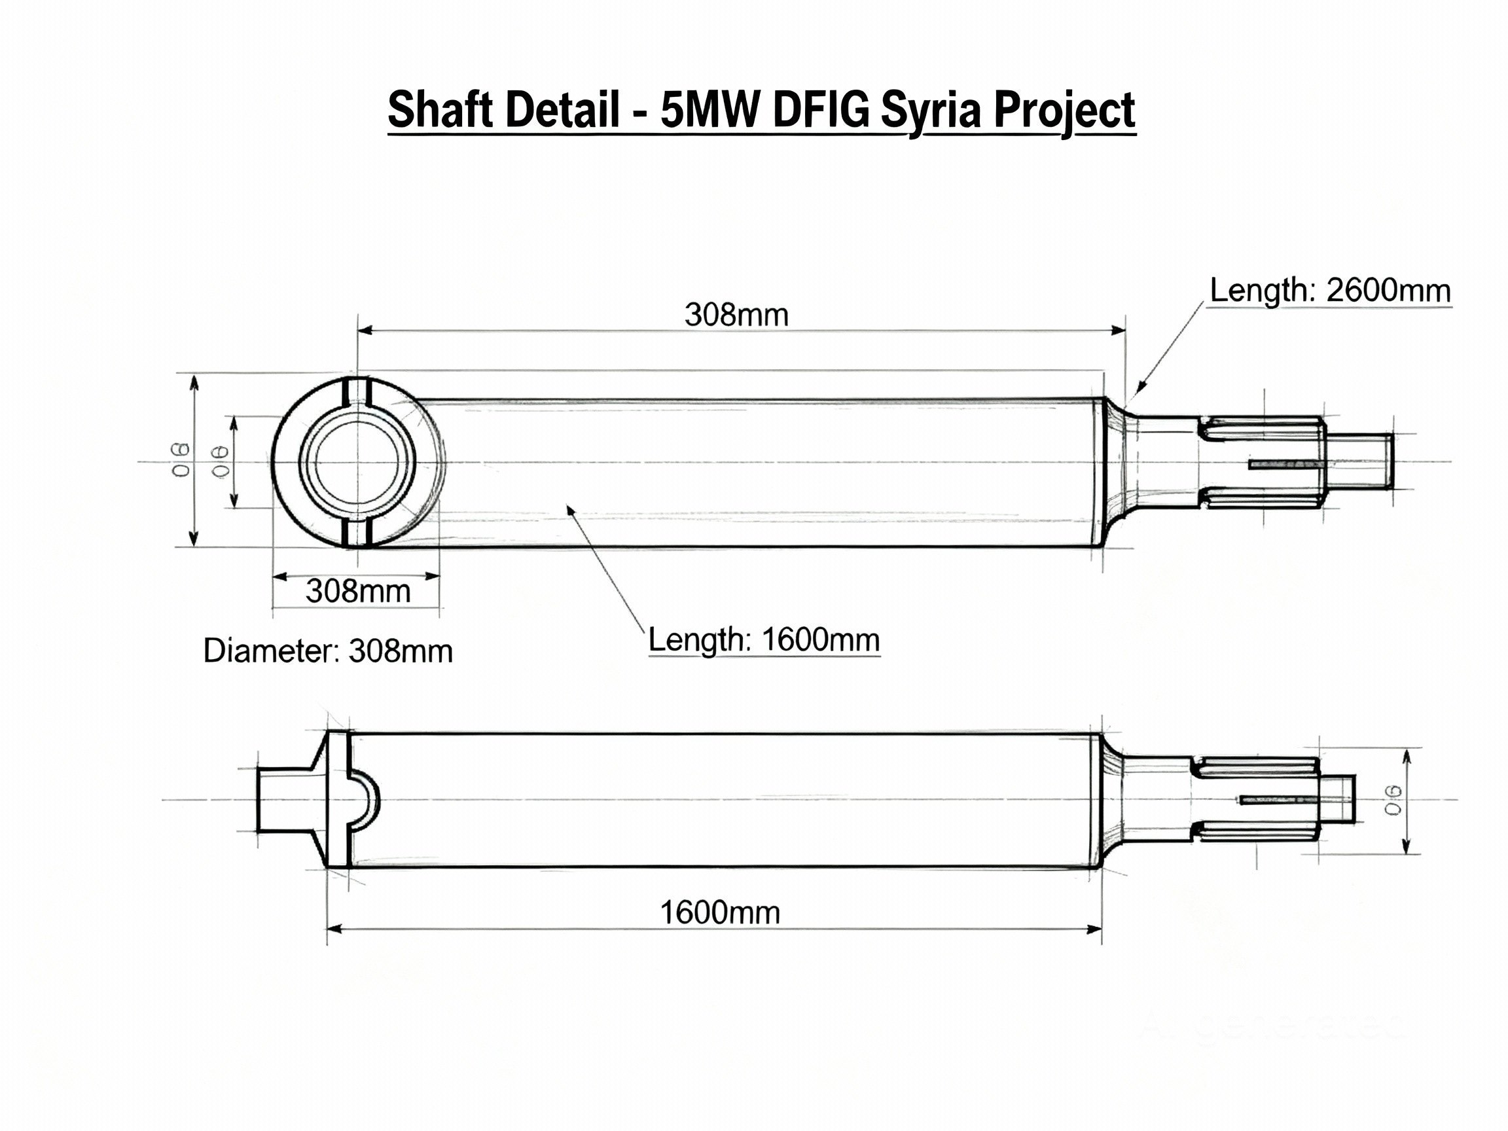
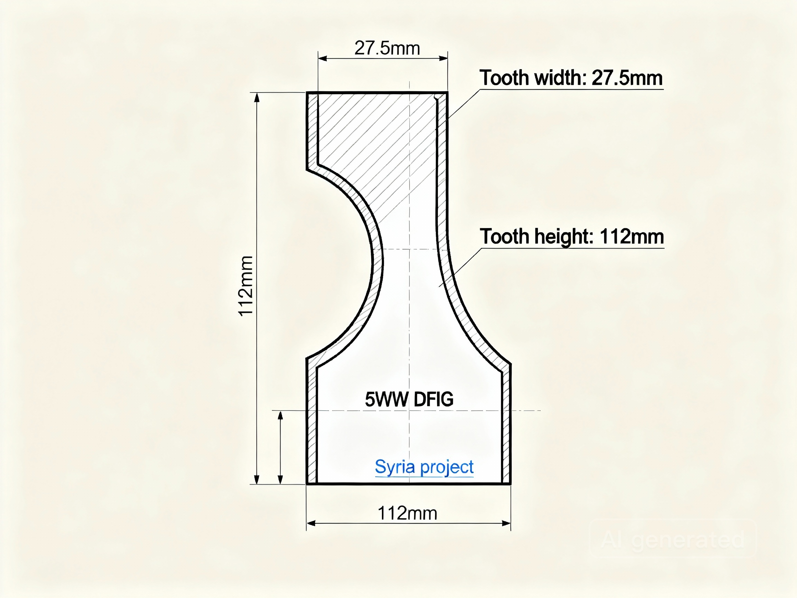
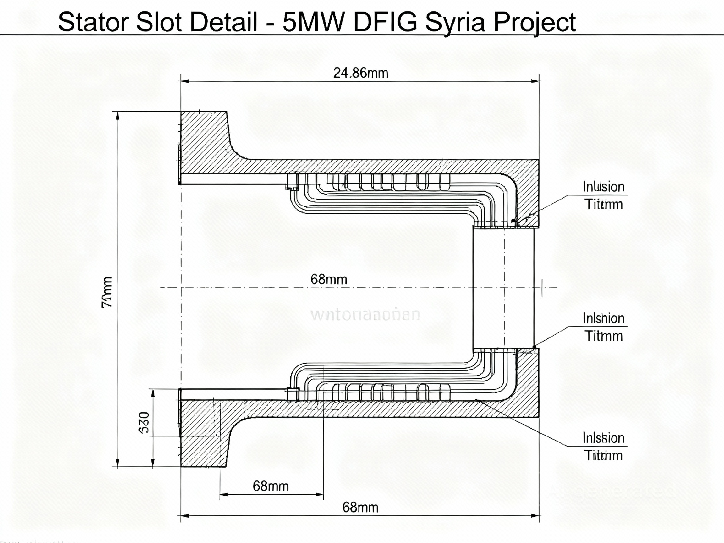
3. Generator Component views
Girish Padalkar
Electrical Drive Train/ Optimus Syria

Slide 6
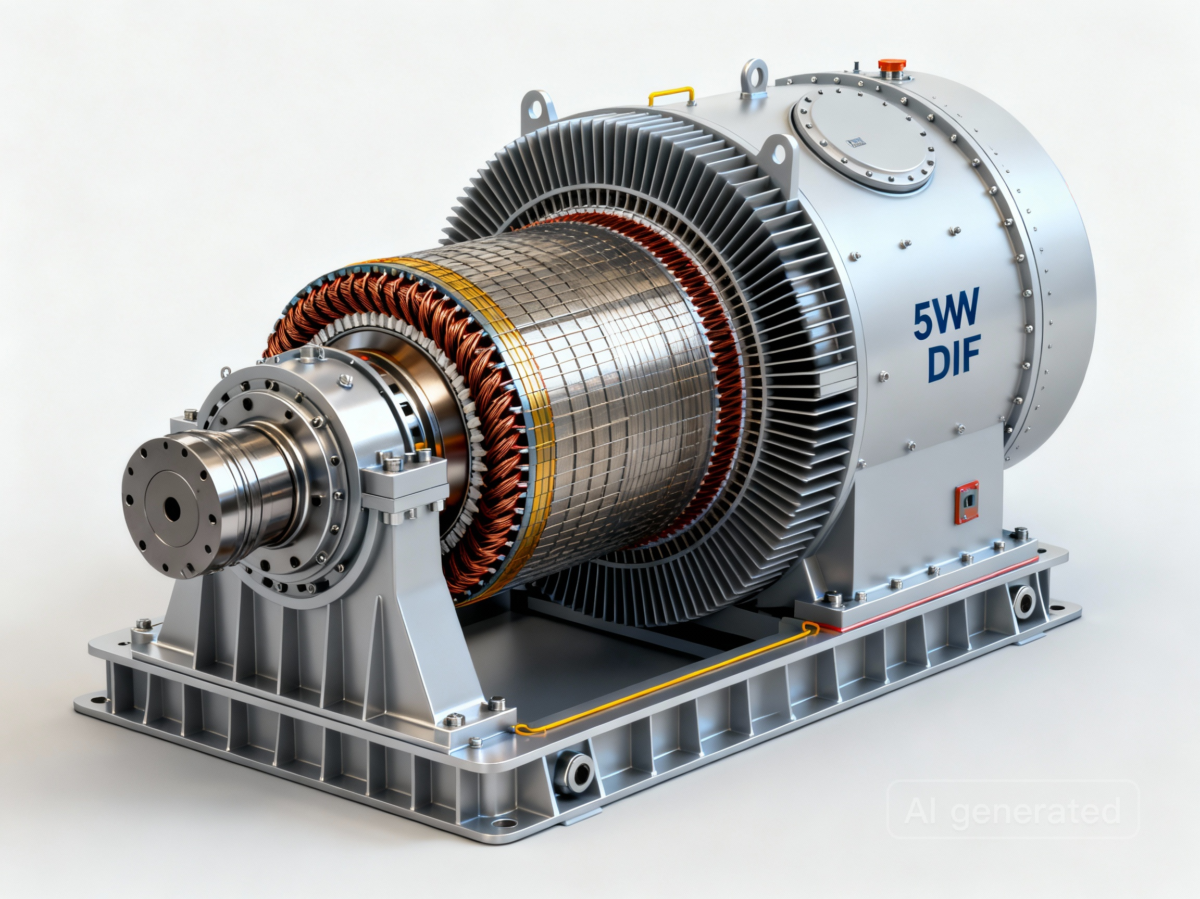
4. DFIG Designing Parameters
Initial design | Parameter
690 V | Terminal voltage
IEC60034 | Standard:
5 MW | Power input
5,239 MVA | Power output
1400mm | Stator inner Diameter Di
1724mm | Stator outer Diameter Do
1390mm | Rotor Outer Diameter
1062.5 mm | Stack length(Stator)
84 | No of slots
6 | No of Poles
24.86mm | Slot width Ws
68mm | Slot depth
1690.5mm² | Slot Area
Girish Padalkar
Electrical Drive Train/ Optimus Syria

Slide 7
4. DFIG Designing Parameters
Initial design | Parameter
7 | No of conductor / slot
0.622 Wb | Flux / pole
4,648.6A | Phase current
419.1mm | Stator yoke height
27.55mm | Tooth width
35℃ to 45℃ | Ambient temperature
50 HZ | Frequency
[3080mm x 1724mm x 1724mm ] | Size [ L ×W×H ]mm
Initial design | Parameter
1000 RPM | Nominal speed
Between 700- 1300 RPM | Speed range
167,112.8 Nm | Nominal torque
40,000- 250,000 NM | Torque range
98% | Efficiency
air-cooled with enhanced ducting | Cooling
IP 54/IP55 or IP56 | Protection class
140 to 180 ton | Weight
Girish Padalkar
Electrical Drive Train/ Optimus Syria

Slide 8
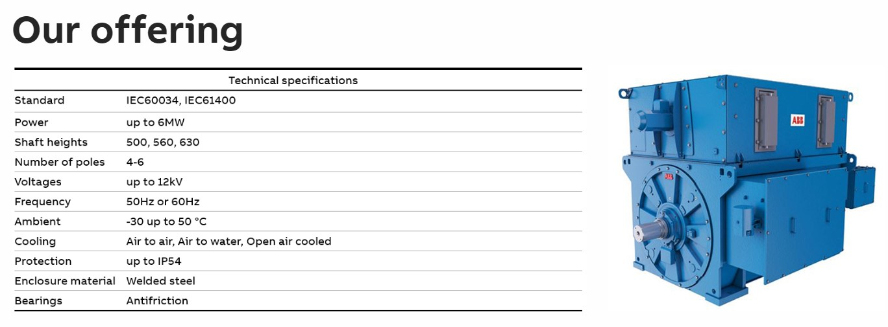
5. ABB Model
Source: https://new.abb.com/motors-generators/generators/generators-for-renewables/doubly-fed-generators
Electrical Drive Train/ Optimus Syria

Slide 9
6.Next Step
Finalize all the Converter parameters.
Finalize the size of each converter components.
Develop the complete DFIG drivetrain model in MATLAB/Simulink.
Girish Padalkar

Slide 10

Bibliography
Pyrhonen, J., Jokinen, T., & Hrabovcova, V. Design of Electrical Machines, 2nd Edition. Wiley. Access Date- 10/11/2025
Li, H., & Chen, Z. (2009). Electrical machines and power-electronic systems for high-power wind energy generation applications. Part II: Power electronics and control systems. [ResearchGate]. https://www.researchgate.net/publication/263364715_Electrical_machines_and_power-electronic_systems_for_high-power_wind_energy_generation_applications_Part_II_-_Power_electronics_and_control_systems Access Date- 06/11/2025
ABB. (2024). Doubly-fed generators for renewables. https://new.abb.com/motors-generators/generators/generators-for-renewables/doubly-fed-generators Access Date- 06/11/2025
11/11/2025
Girish Padalkar
9

